Slide 1
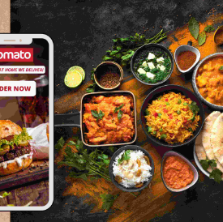
Zomato Restaurant Management System
SUSMITA MAITY
19/02/2024

Slide 2

Agenda
Introduction
Brief Overview of Zomato as a Platform
Analytical Approach and Tools
Dashboard and Visualizations
Conclusion

Slide 3
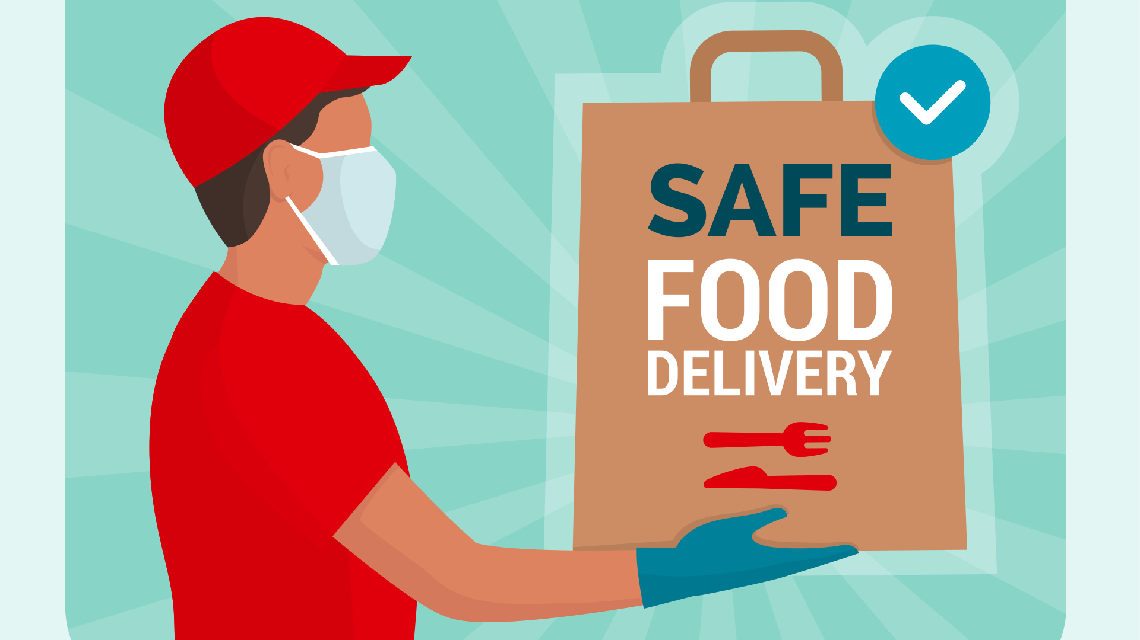
Introduction
Zomato: A global food delivery and restaurant discovery platform founded in 2008, now serving over 90 million users across 25+ countries. Features extensive restaurant listings, menus, reviews, and ratings.

Slide 4
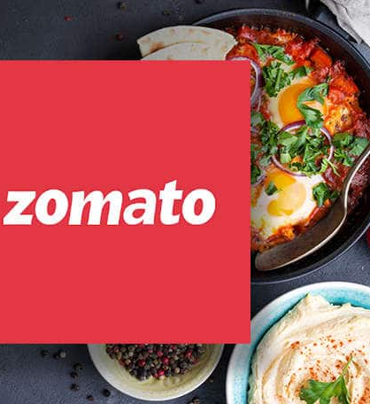
Brief Overview of Zomato as a Platform
Total number of restaurants across the world: 9551
Total countries served: 15
Total type of cuisines available throughout the world: 1825
Geographical coverage: Services reach 43 Indian cities, showing nationwide penetration.
Data cleaning and Preprocessing:
Unified product categories for a consistent classification across the platform
Addressed missing values in Cuisines section to enhance data integrity
This dataset allows for an in-depth understanding of Zomato’s market presence and operational scope.
Insights from user demographics and order volumes are key to optimizing marketing strategies and expanding product offerings.

Slide 5

Analytical Approach and Tools
Data Cleaning: Used Trim, IF, and Mode functions to ensure
accuracy and handle missing values.
Data Enrichment: Enhanced dataset with VLOOKUP and XLOOKUP to
incorporate additional variables from external sources.
Descriptive Analysis: Employed Pivot Tables to summarize metrics and
identify distribution patterns by region and cuisine.
Visualization: Developed dynamic charts and dashboards for interactive
data exploration and representation.

Slide 6
New restaurant opening ideas:
Country | Average of Rating | Restaurant Count
Australia | 3.7 | 24
Brazil | 3.8 | 60
Canada | 3.6 | 4
India | 2.8 | 8652
Indonesia | 4.3 | 21
New Zealand | 4.3 | 40
Philippines | 4.5 | 22
Qatar | 4.1 | 20
Singapore | 3.6 | 20
South Africa | 4.2 | 60
Sri Lanka | 3.9 | 20
Turkey | 4.3 | 34
United Arab Emirates | 4.2 | 60
United Kingdom | 4.1 | 80
United States of America | 4.0 | 434
 | 3.9 | 9551
Here we can see the data for opening new restaurants based on the aforementioned matrix:
We can see where the number of restaurants are lesser than 40, we can grow our business there.
We can also reach out to the places where the average rating of the food is equal to or above 3.6 to be considered to be a good show of ratings in terms of services provided.
From that ,we can conclude these countries to be ideal:
Australia, Canada, Indonesia, Philippines, Qatar, Singapore and Sri Lanka

Slide 7
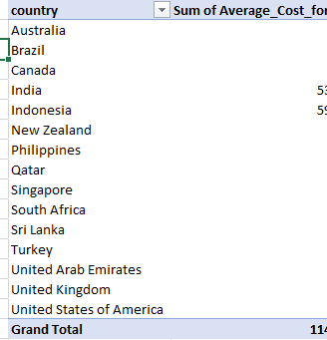
Expenditure vs Ratings Analysis
As per the current calculation if we issue a pivot chart for average price range vs ratings and number of restaurants suggested, we can see that most of them falls between 2 and 3, and only Qatar and Singapore are at 4, where the ratings are good but no’s of restaurants are less.
People are liking more expensive food and ambience rather than cheaper options available.
The below mentioned graph shows the data exactly:

Slide 8
Biggest and lowest competitors:
Restaurants that are our biggest competitors in suggested countries: 72 in total are above 4.0 Rating
Restaurant Name | Rating
Pier 70 | 2.6
Consort Restaurant | 3
Makansutra Gluttons Bay | 3
Poets Cafe | 2.4
Star Buffet | 2.9
Elite Indian Restaurant | 2.4
Queen's Cafe | 2.5
Restaurant Name | Rating
Mainland China Restaurant | 4.9
Ooma | 4.9
Ministry of Crab | 4.9
Spiral - Sofitel Philippine Plaza Manila | 4.9
Talaga Sampireun | 4.9
Sushi Masa | 4.9
Talaga Sampireun | 4.9
8

Slide 9
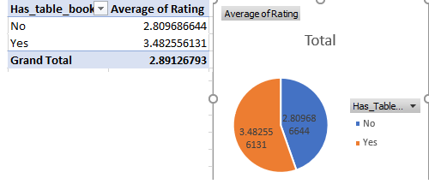
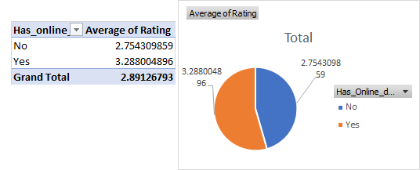
Online table booking and online delivery approaches
 | Votes | (Multiple Items)
 | Cuisines Name | Average of Rating
 | American, Burger, Cafe | 4.7
Online Delivery | Yes | 4.7
Table Booking | No | 4.7
 | Chinese, North Indian | 4.2
Online Delivery | Yes | 4.2
Table Booking | No | 4.2
 | Continental, American, Asian, North Indian | 4.3
Online Delivery | Yes | 4.3
Table Booking | Yes | 4.3
 | Continental, North Indian | 4.3
Online Delivery | Yes | 4.3
Table Booking | No | 4.3
 | European, Mediterranean, North Indian | 4.75
Online Delivery | No | 4.75
Table Booking | No | 4.75
 | Finger Food, North Indian, Italian, Continental, Thai, South Indian | 4.5
Online Delivery | Yes | 4.5
Table Booking | Yes | 4.5
 | Italian, American, Pizza | 4.8
Online Delivery | No | 4.8
Table Booking | No | 4.8
 | North Indian, Chinese | 4.9
Online Delivery | No | 4.9
Table Booking | No | 4.9
 | North Indian, European, Mediterranean | 4.1
Online Delivery | No | 4.1
Table Booking | Yes | 4.1
High ratings are often given when table booking or online delivery service is available, showing that customers like having these options.
Customers really value the convenience and time saved by online table booking and delivery services.
If we see the top 10 cuisines according to the number of votes then we can find 6 of those are having online delivery or table booking system. And all of those are highly rated (4+)
So introducing the online delivery and table booking become good for customers

Slide 10
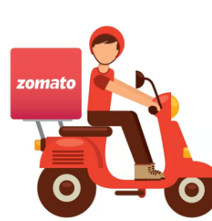
Explanation of approaches
Analyzing Market Demand:
Use the "Number of Restaurants" and "Average Rating" metrics to identify countries/cities with high demand and positive reception for restaurants.
Utilize "Average Cost_for_two" to understand the affordability factor in different areas.
Identifying Untapped Markets:
Examine countries/cities with fewer existing restaurants, potentially indicating underserved markets.
Look for locations with low competition but high population density or tourism traffic.
Assessing Economic Viability:
Consider the currency and average cost for two to evaluate the economic feasibility of opening a restaurant in different countries/cities.
Analyze GDP per capita and economic growth indicators of potential locations.

Slide 11
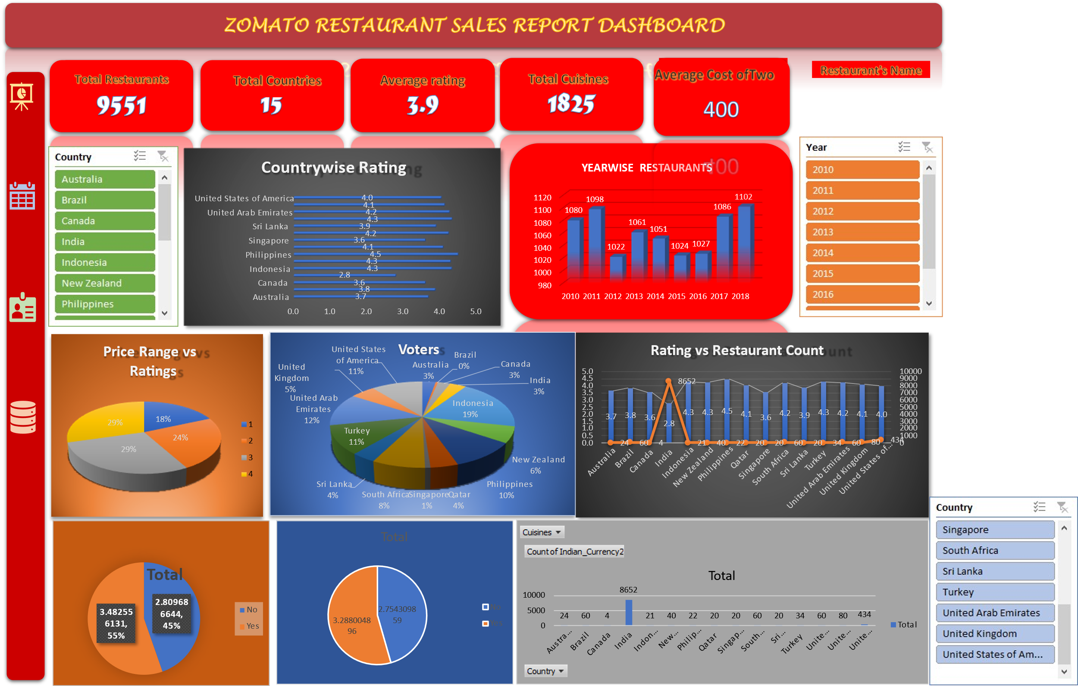

Slide 12
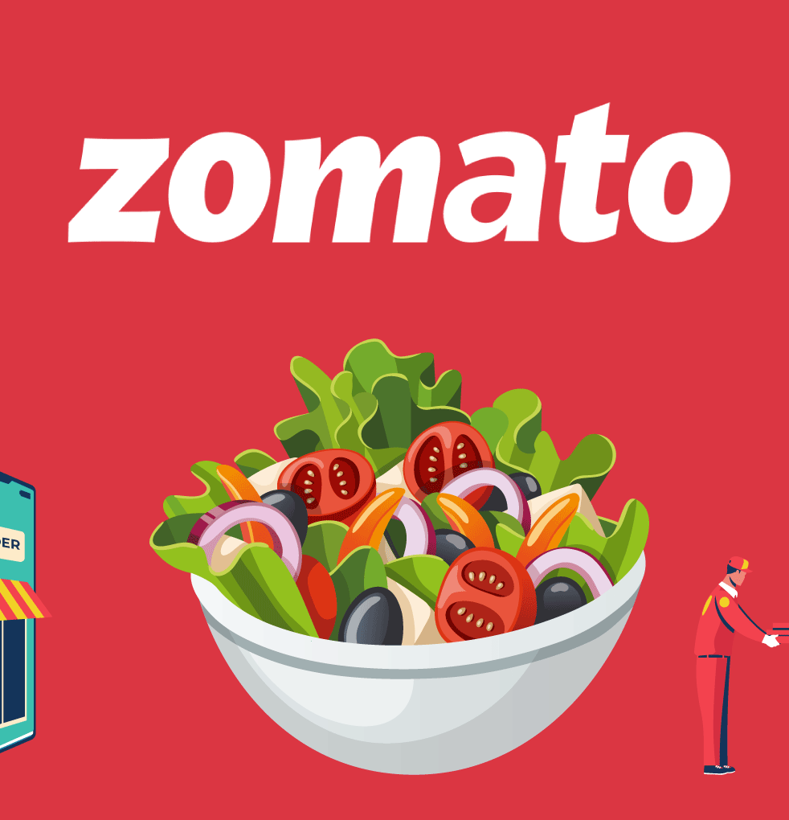
Summary
The main work of Zomato is to suggest local and nearby restaurants to users and receive orders from them. Users can place orders from their favourite restaurant based on ratings and reviews shared by previous customers. Zomato's success can be attributed to its innovative business model, its focus on customer experience, and its ability to adapt to changing market conditions. As the food delivery industry continues to grow and evolve, Zomato is well-positioned to continue its success and expand its reach into new markets.

Slide 13
Thank You
Susmita Maity.
chaitysusmita1997@gmail.com

